Slide 1
Leave Management System for School
By:
B. Sushma Sri

Slide 2
Table of contents
Abstract
Existing Problem
Proposed Solution
System Requirements
Technologies Used
Workflow
Database Used
Results
Conclusion

Slide 3
Abstract
This project is aimed at developing a Leave Management Tool, which is of importance to an organization.
The Easy Leave is an Intranet based application that can be accessed throughout the organization.
This system can be used to automate the workflow of leave applications and their approvals.

Slide 4
Abstract
The periodic crediting of leave is also automated. There are features like cancellation of leave, automatic approval of leave, report generators etc.,in this Tool.
There are registered people in the system. Some are approvers. An approver can also be a requestor.
In an organization, the hierarchy could be Students / Teachers / Vice-Principal / Principal etc.

Slide 5
Existing Problem
In the existing Leave Record Management System, every School follows manual procedure in which faculty enters information in a record book.
At the end of each month, Administrator calculates leave of every member which is a time taking process and there are chances of losing data or errors in the records.
The staff needs to submit their leaves manually to their respective authorities. This increases the paperwork & maintaining the records becomes tedious.

Slide 6
Existing Problem
In schools if a student wants to apply leave he/she have to write a leave letter and submit to respective teacher.
For a single teacher it is difficult to maintain all leave records of all students in a class and some times leads to loss of data or errors.
It also increase the paper work.
Finally maintaining of all leave records of students and faculty in a school manually is very difficult.

Slide 7
Proposed Solution
To decrease the paperwork and for easier record maintenance an intranet based application is introduced.
Leave Management System is an application for a school which is used for applying leaves by students and teachers and maintain those all leave records easily.
A school can maintain all records of students and staff easily by having a particular centralized Database System.

Slide 8
Proposed Solution
To automate the system of applying leave by students and teachers an intranet based application is required.
A student or a teacher can apply leave in advance by specifying cause of leave and respective authority can approve or reject leave based on requirements.
This will help students/teachers to apply leave easily and check their leave status.
School also get benefitted by easy maintenance of all records of students and staff leaves.

Slide 9
System Requirements
Hardware requirements
Minimum : Pentium IV Processor with 1.2GHZ
Hard Disk : 500GB
RAM : 2GB
Display : LCD Monitor

Slide 10
System Requirements
Platform Specification
Operating system : Any Operating System after WINDOWS 2000
Front End : HTML, CSS
Database : PHP, MYSQL Database

Slide 11
Technologies Used
Front End : HTML , CSS
Back End : PHP
Data Base: MySQL

Slide 12
Brief overview of the technology
1 . HTML
HTML stands for Hyper Text Markup Language
HTML is the standard markup language for creating Web pages
HTML describes the structure of a Web page
HTML consists of a series of elements
HTML elements tell the browser how to display the content
HTML elements label pieces of content such as "this is a heading", "this is a paragraph", "this is a link", etc.

Slide 13
Brief overview of the technology
2. CSS
CSS stands for Cascading Style Sheets
CSS describes how HTML elements are to be displayed on screen, paper, or in other media
CSS saves a lot of work. It can control the layout of multiple web pages all at once
External stylesheets are stored in CSS files
CSS is used to define styles for your web pages, including the design, layout and variations in display for different devices and screen sizes.

Slide 14
Brief overview of the technology
3. PHP
PHP is an acronym for "PHP: Hypertext Preprocessor"
PHP is a widely-used, open source scripting language. PHP scripts are executed on the server
It is powerful enough to be at the core of the biggest blogging system on the web. It is deep enough to run the largest social network
PHP files can contain text, HTML, CSS, JavaScript, and PHP code
PHP can generate dynamic page content and collect data from user.

Slide 15
Brief overview of the technology
4.MySQL
MySQL is the most popular Open Source Relational SQL Database Management System.
MySQL is one of the best RDBMS being used for developing various web-based software applications.
MySQL is developed, marketed and supported by MySQL AB, which is a Swedish company.

Slide 16
Brief overview of the technology
SQL
SQL stands for Structured Query Language
SQL lets you access and manipulate databases
SQL can execute queries against a database
SQL can retrieve data from a database
SQL can insert , delete ,update records of Database.
SQL can create new databases
SQL can create new tables in a database

Slide 17
Work Flow
A person should be able to login to the system through the login page of the application, change the password, apply for leave specifying the from and to dates, and approve/ reject the leave applications that are submitted to him / her. As soon as a leave application / cancellation request /approval / rejection is made by the person he / she will be notified.
The number of days of leave (as per the assumed leave policy) should be automatically credited to everybody.
The processing leave should be approved by the system automatically after some days.

Slide 18
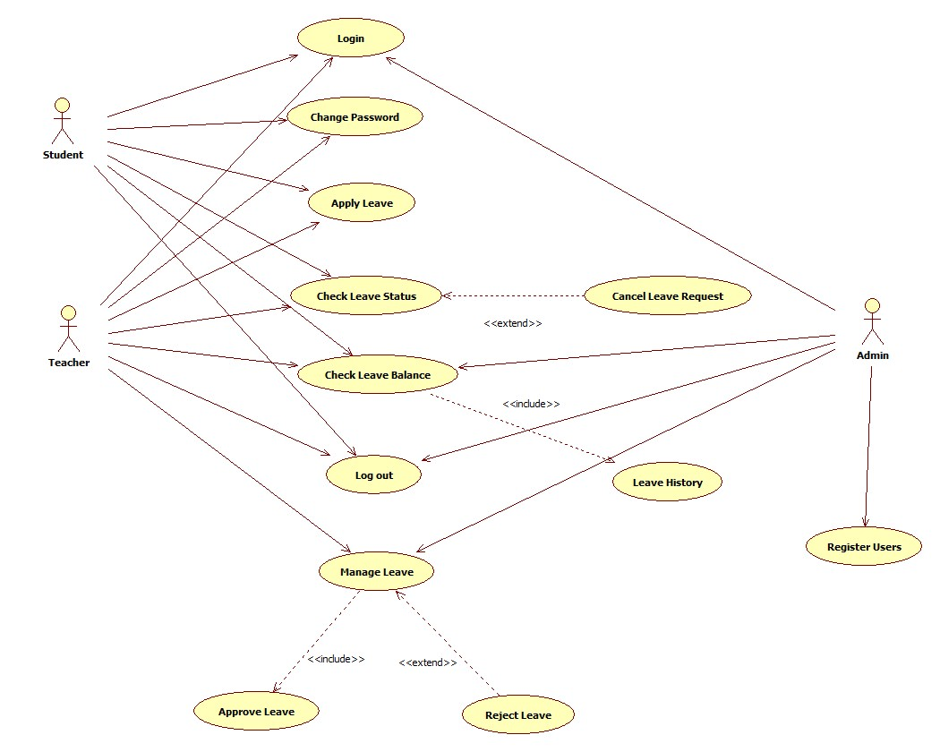
Use Case Diagram For Leave Management System

Slide 19
Activity Diagram for Apply Leave

Slide 20
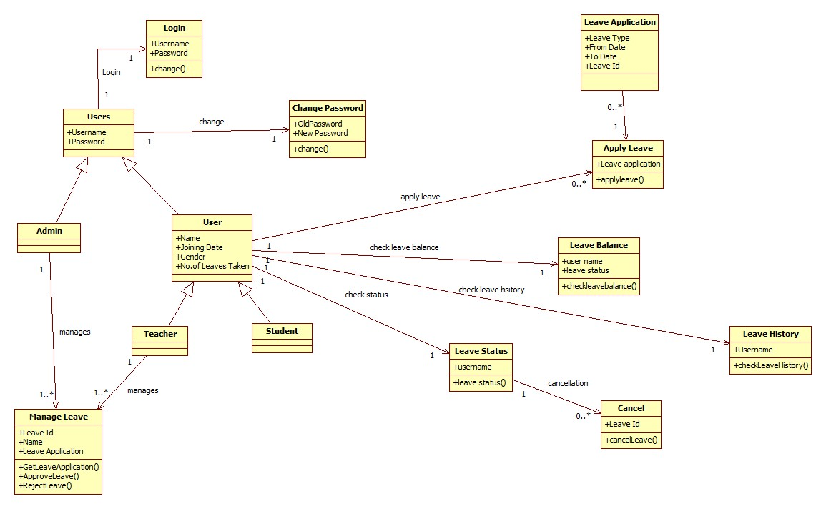
Class Diagram for Leave Management System

Slide 21
Work Flow
This project have total 3 modules
Student Module
Teacher Module
Admin Module

Slide 22
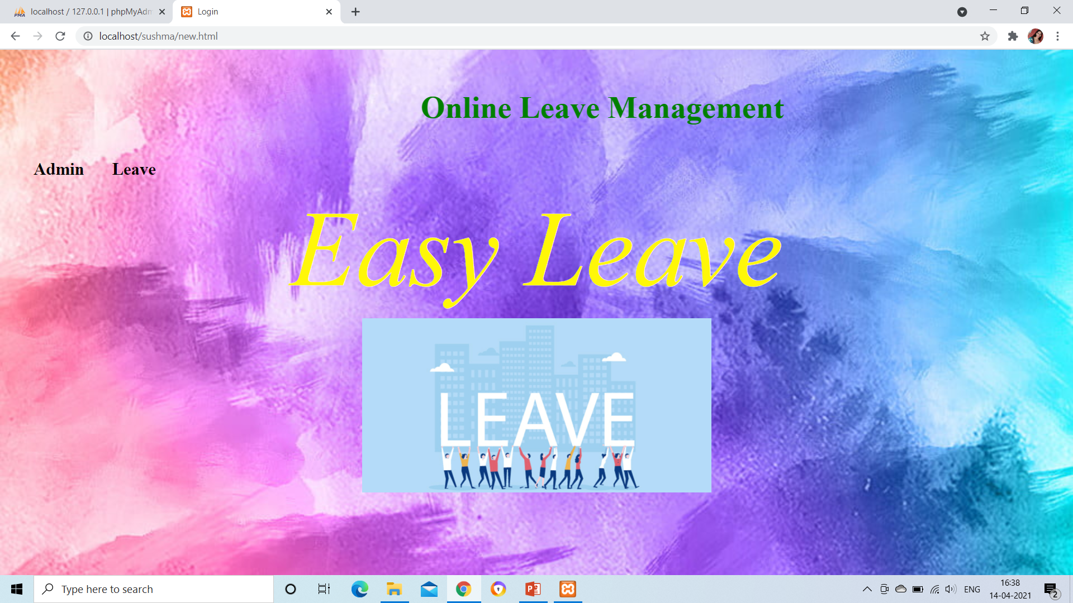
Work Flow

Slide 23
Work Flow
Admin Module
First for the initial application page by clicking on Admin ,it will redirect to admin login page.
For accessing this application ,Admin have to login with his unique username and password.
After logged in as Admin he will be redirected to his Admin Module.

Slide 24
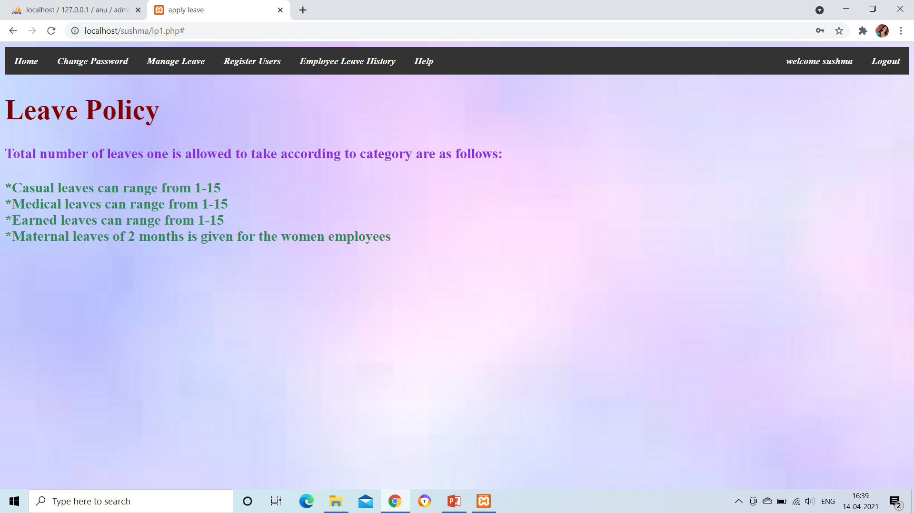
Work Flow

Slide 25
Work Flow
Admin module have several functions like:
Change Password: Admin can change his password by giving old password and new password he wants to update.
Manage Leave : In this section of page admin get requests from teachers for leave. Admin may approve or reject the leaves applied by staff.
Register Users : Main duty of Admin is to register users. Admin can register teacher or student in this application system by giving their details such as name,student/teacher, password,username and so on.

Slide 26
Work Flow
Employee Leave History: Records of all teachers leaves are maintained. These records contain information like Teacher name, type of leave applied , no.of days applied , status of leave(approved/pending/rejected).
Help: If a new user doesn’t know how to access this application he can access this page and it gives detailed information of this application and help them to access application.

Slide 27
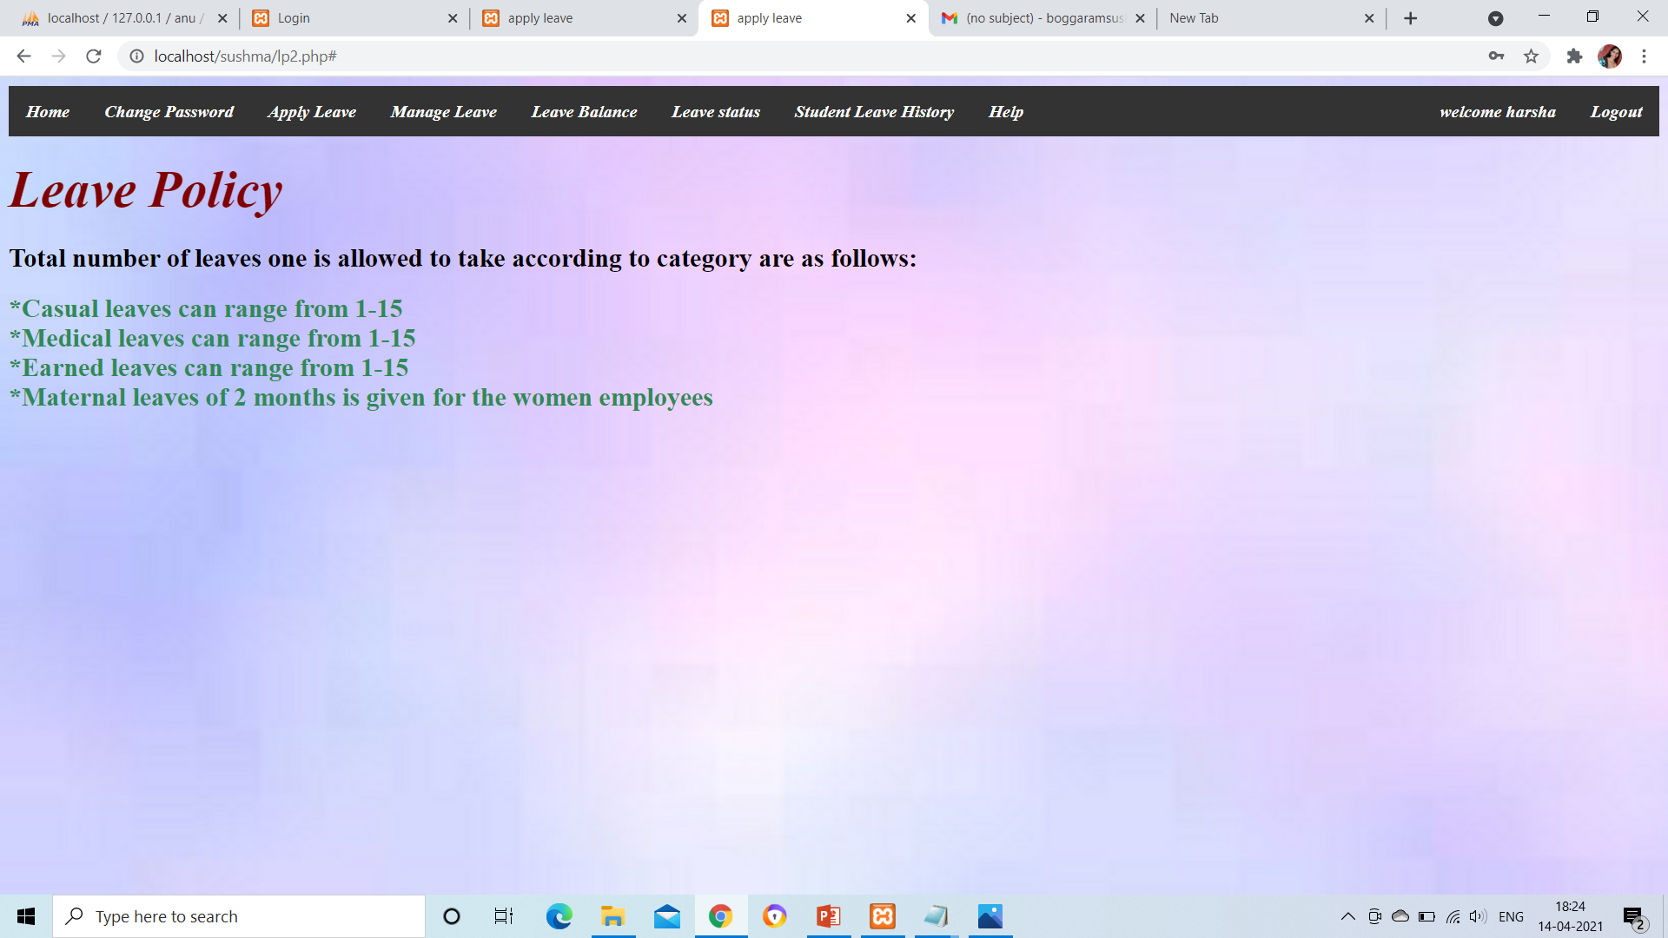
Work Flow
Teacher Module

Slide 28
Work Flow
Teacher Module functionalities are:
Change Password: A teacher can change password by giving old password as a proof of identity and a new password to change.
Apply Leave: A teacher can apply leave by specifying type of leave(casual/medical/earned/meternity) along with from date and to date. A request of this leave send to admin.

Slide 29
Work Flow
Manage Leave: Students’ leave requests are send to teacher. Teacher can approve or reject student leave.
Leave Balance : A table of no.of days of leave left for each of type is left is displayed.
Leave Status: The status(approved/pending/rejected) of applied is displayed.
Student Leave History : A record of all students leave details is maintained.It contains name of student, type of leave applied and no.of days applied and so on…

Slide 30
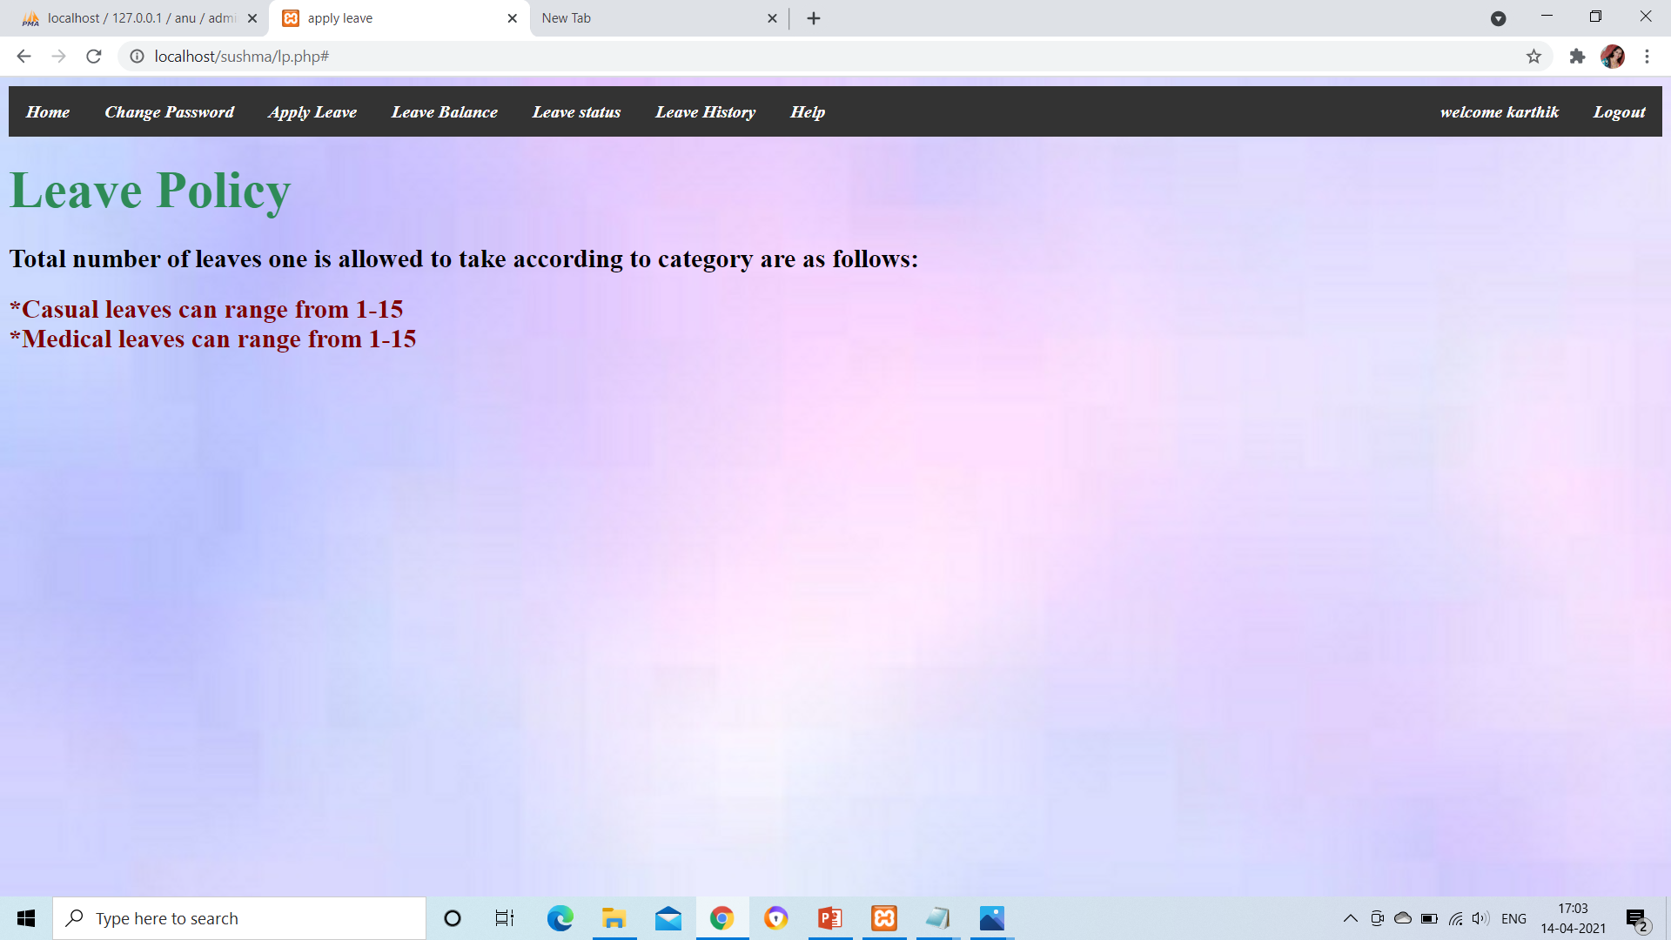
Work Flow
Student Module

Slide 31
Work Flow
Student Module Functionalities are:
Change Password : A student can change password by giving old password as a proof and a new changed password.
Apply Leave : A student can apply leave by specifying type of leave,from date and to date.
Leave Balance: A table of type of leave along with no.of days left is displayed.

Slide 32
Work Flow
Leave Status: The status of applied leave is displayed.
Leave History : A record of all applied leave details is maintained. It has type of leave,no.of days applied and status of each leave.

Slide 33
Database Used
To Implement Leave Management System for School a database with 9 tables are created
Admin Login
Teacher Login
User Name
Password
User Name
Password

Slide 34
Database Used
To Implement Leave Management System for School a database with 9 tables are created
Student Login
Leave Type Table
User Name
Password
Type of Leave
No.of Days

Slide 35
Database Used
Information of Teacher
Information of Student
Name
Id(Primary Key)
Gender
Joining Date
Email Id
Name
Id(Primary Key)
Gender
Joining Date
Email Id

Slide 36
Database Used
Leave Information of Teacher
Leave Information of Student
Name
Leave Id(Primary Key)
Type of Leave
No.of Days
From Date
To Date
Status
Name
Leave Id(Primary Key)
Type of Leave
No.of Days
From Date
To Date
Status

Slide 37
Database Used
Reason for Rejection of Leave
Leave Id
Reason

Slide 38
Results
For running a web application Server is required along with proper Database Connection.
Leave Management System ,an Intranet based application to work ,XAMPP server is required.
This application is placed in XAMPP and executed in localhost.

Slide 39

Output
Index Page of Leave Management System:(new.html)

Slide 40
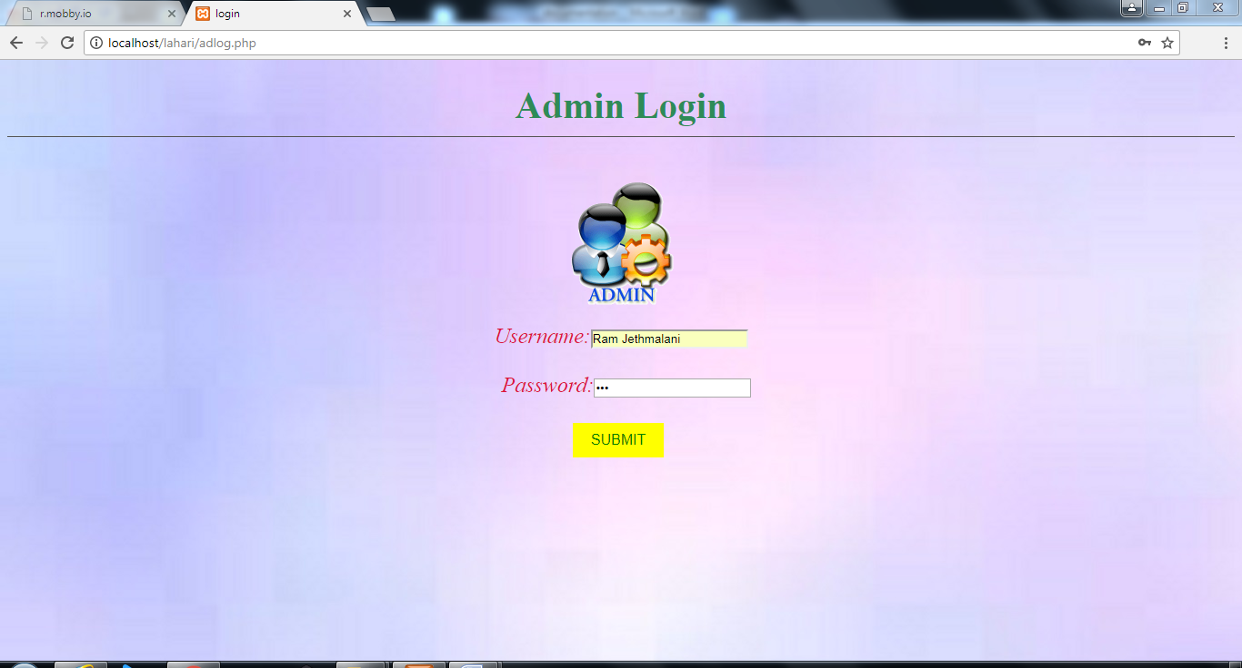
Output(Admin Module)
Admin Login Page:(adlog.php)

Slide 41
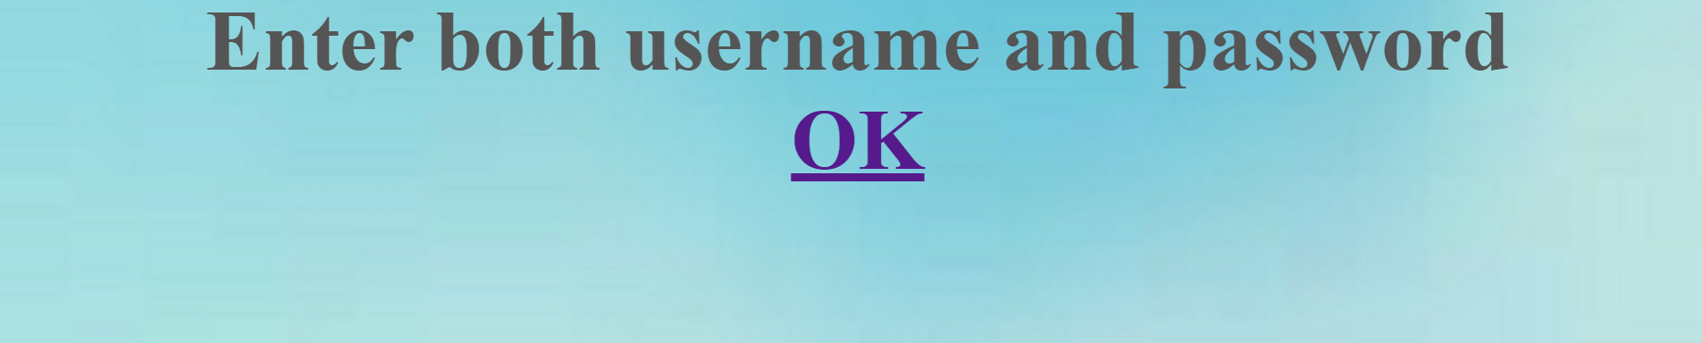

Output(Admin Module)
Login Outputs
When admin doesn’t enter both username and password. (inca1.php)
When admin entered incorrect username or password. (inca.php)

Slide 42
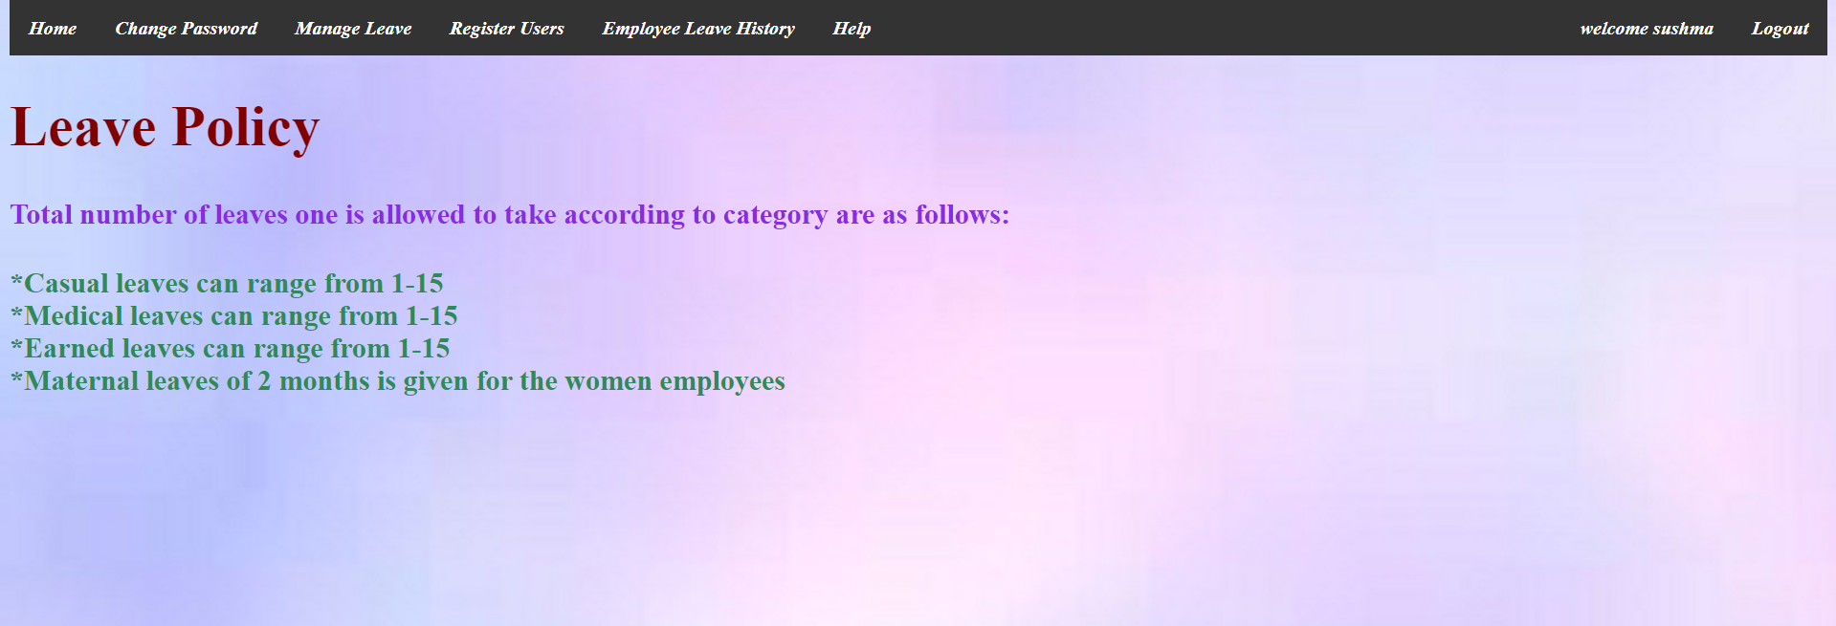
Output(Admin Module)
Login Output
When admin entered correct username and password it will redirect to admin page.(lp1.php)

Slide 43
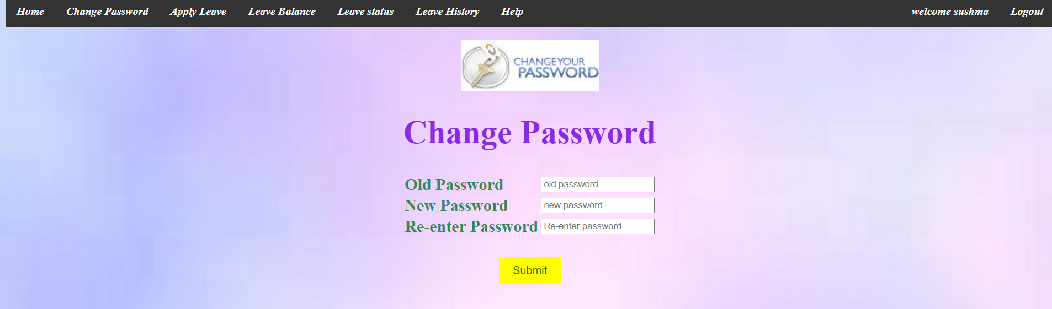
Output(Admin Module)
Change Password(changepass1.php)

Slide 44


Output(Admin Module)
Change Password Outputs
When user enters incorrect old password(ca1.php)
When user entered new password and re-entered password doesnot match(ca2.php)

Slide 45

Output(Admin Module)
When old password is correct and new passwords matched, password of user will change.(ca3.php)

Slide 46
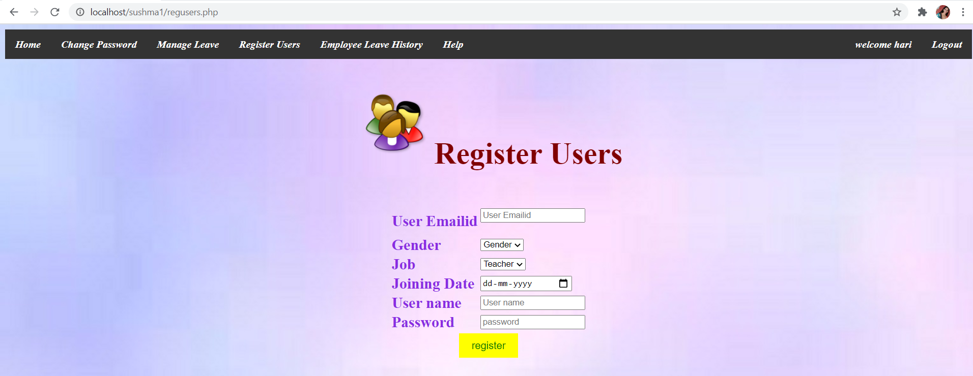
Output(Admin Module)
Register Users(regusers.php)

Slide 47
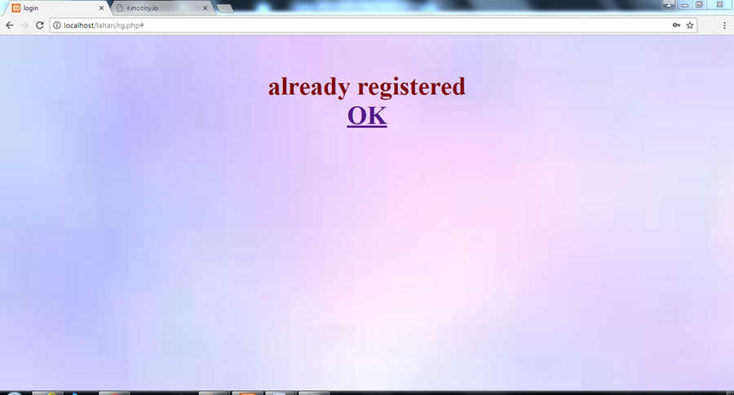
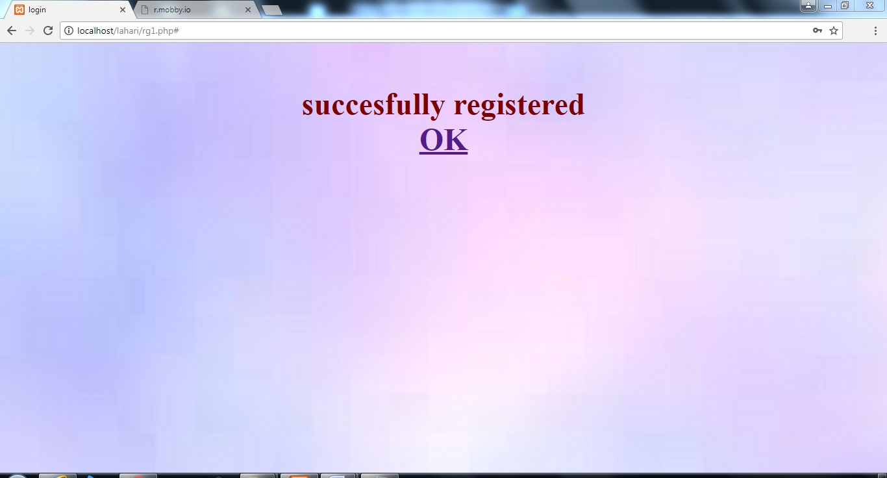
Output(Admin Module)
If user already registered
If user not yet registered

Slide 48
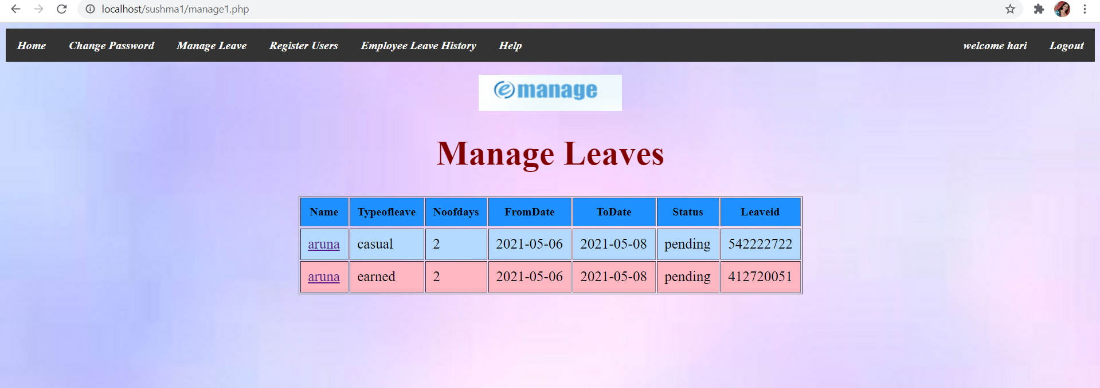
Output(Admin Module)
Manage Leave(manage1.php)
Admin gets leave request from Teachers he may approve or reject it.

Slide 49


Output(Admin Module)
Manage Leave Output(approval1.php)
approve1.php

Slide 50
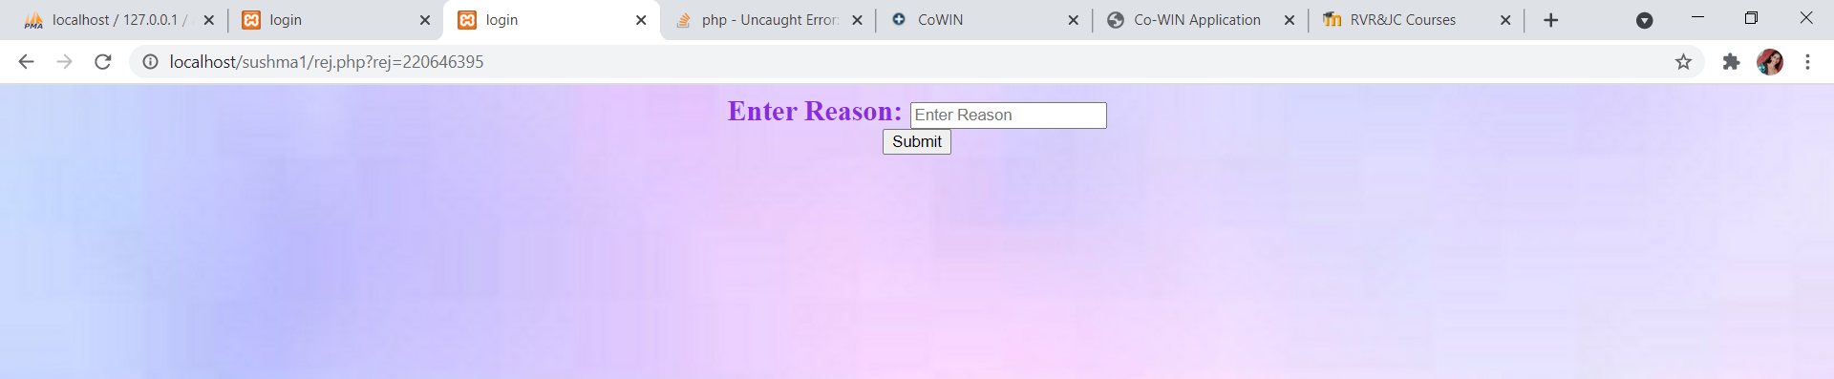
Output(Admin Module)
Manage Leave Output(approval1.php)
rej1.php

Slide 51

Output(Admin Module)
reject.php

Slide 52
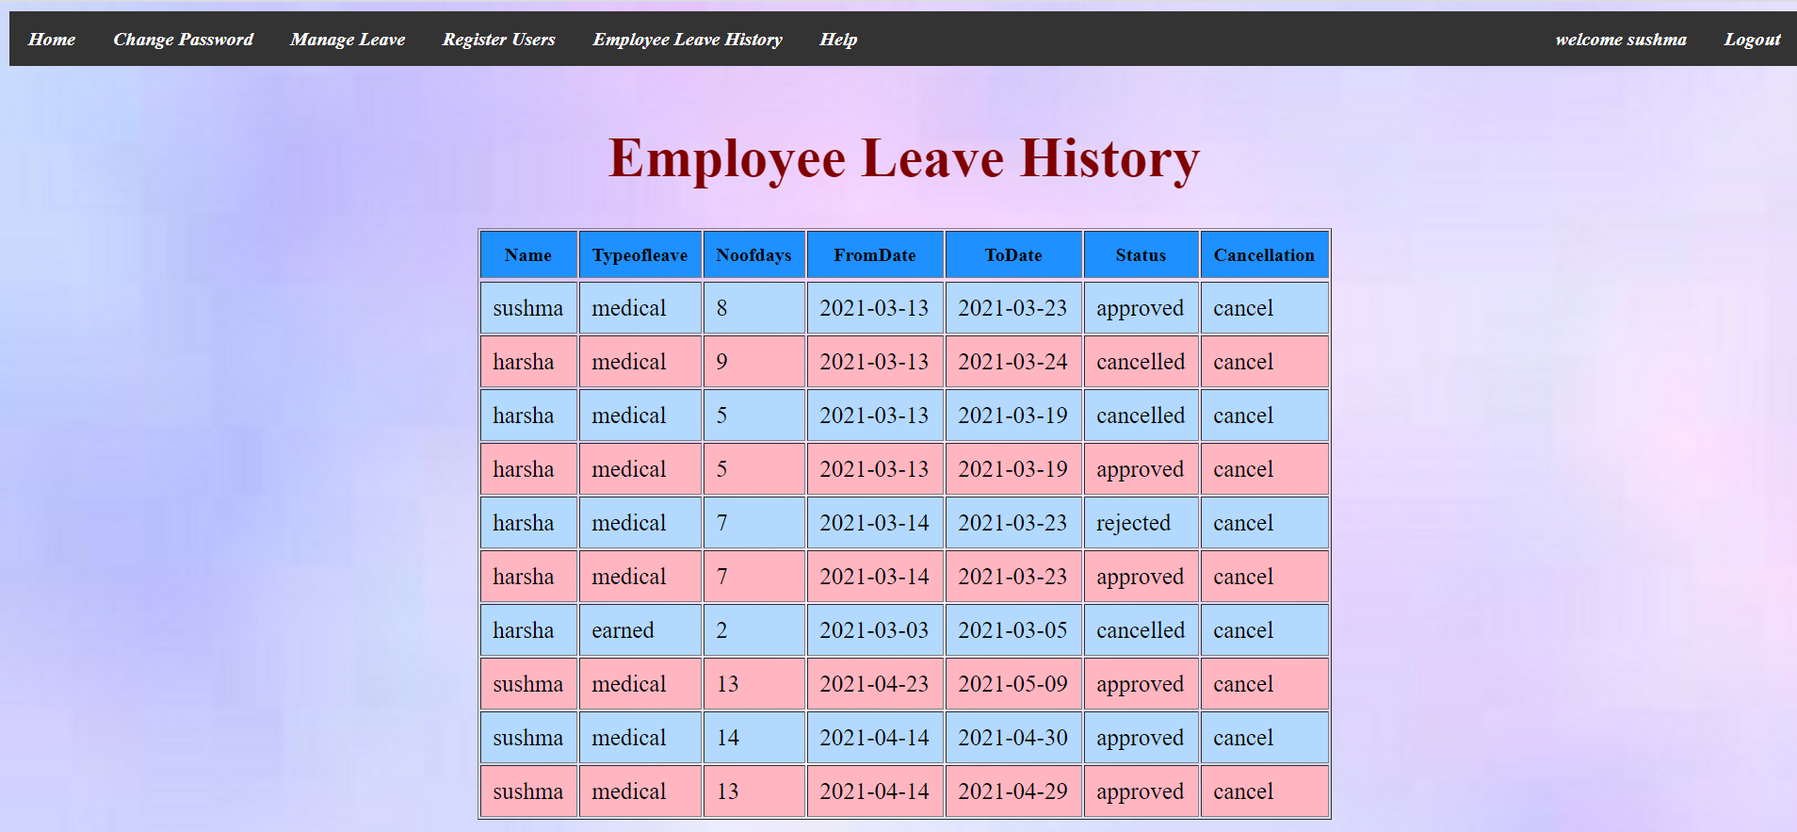
Output(Admin Module)
Employee Leave History(leavehistory3.php)

Slide 53
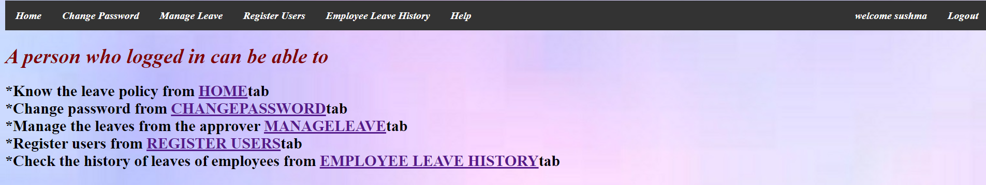
Output(Admin Module)
Help(help3.php)

Slide 54

Output(Apply Leave)
new.html
-> new1.html

Slide 55

Output(Teacher Module)
Teacher Login(login3.php)

Slide 56
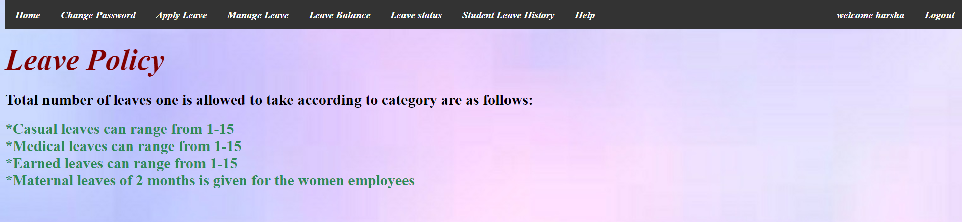
Output(Teacher Module)
lp2.php

Slide 57
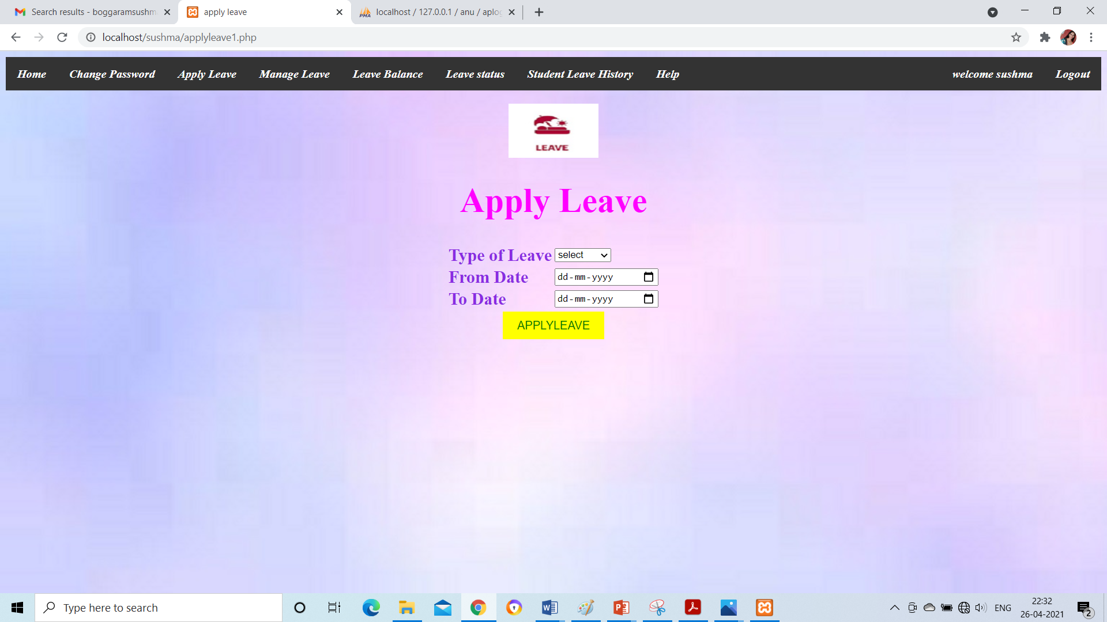
Output(Teacher Module)
Apply Leave:(applyleave1.php)

Slide 58
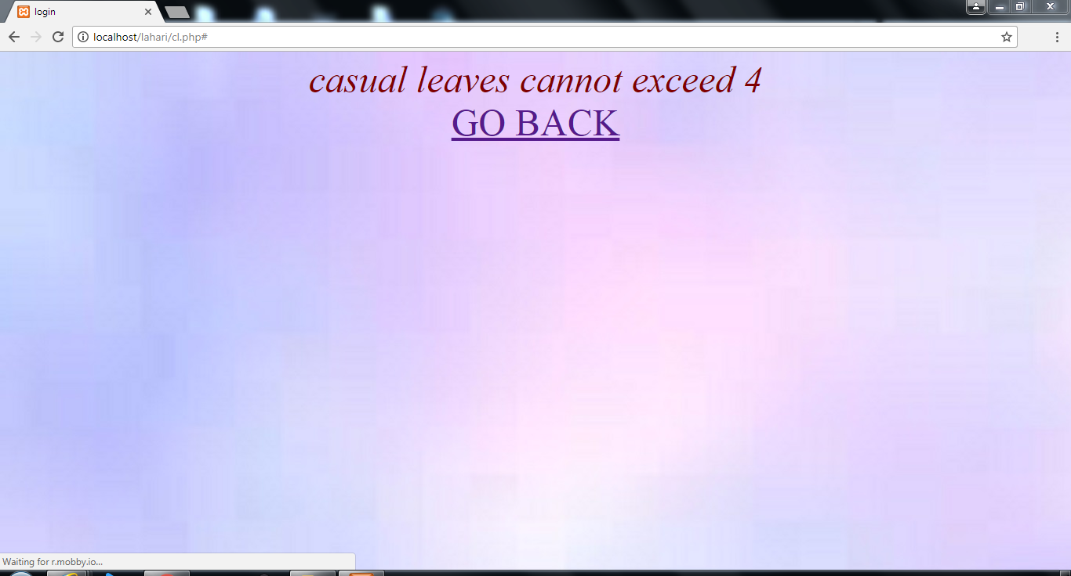
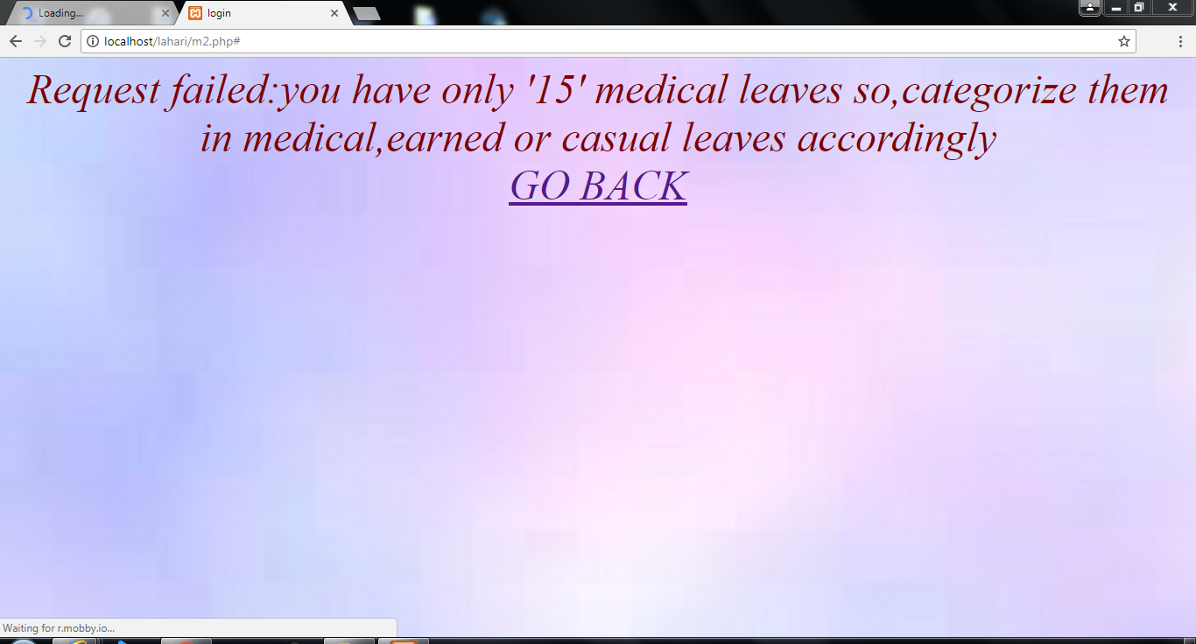
Output(Teacher Module)
When the necessary conditions are not satisfied while applying leave:

Slide 59
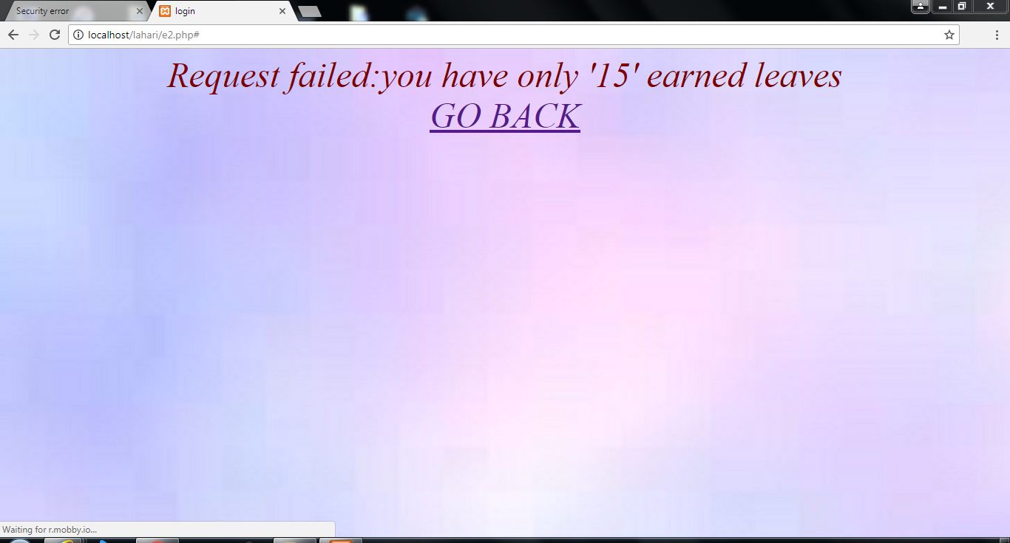
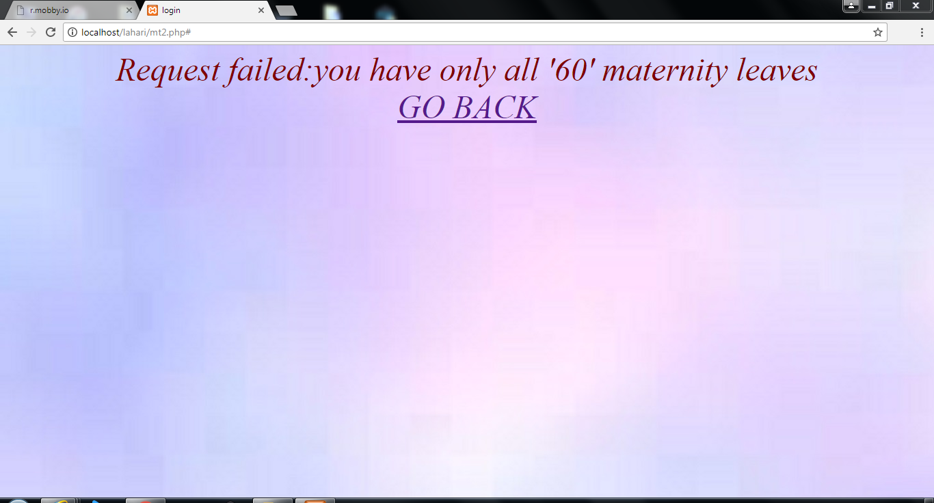
Output(Teacher Module)
When the necessary conditions are not satisfied while applying leave:

Slide 60

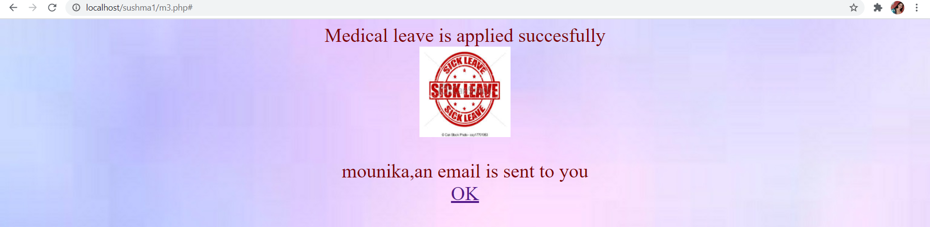
Output(Teacher Module)
When all leave conditions are satisfied then:

Slide 61
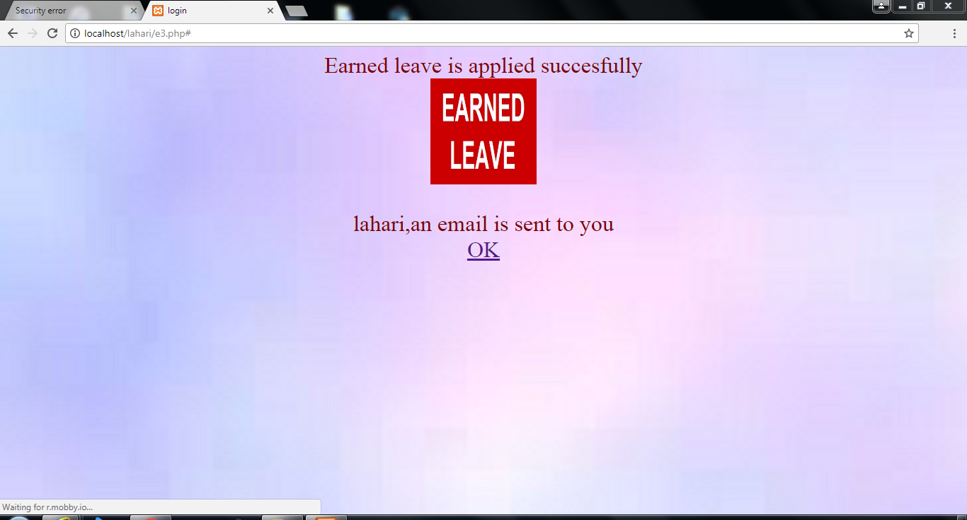
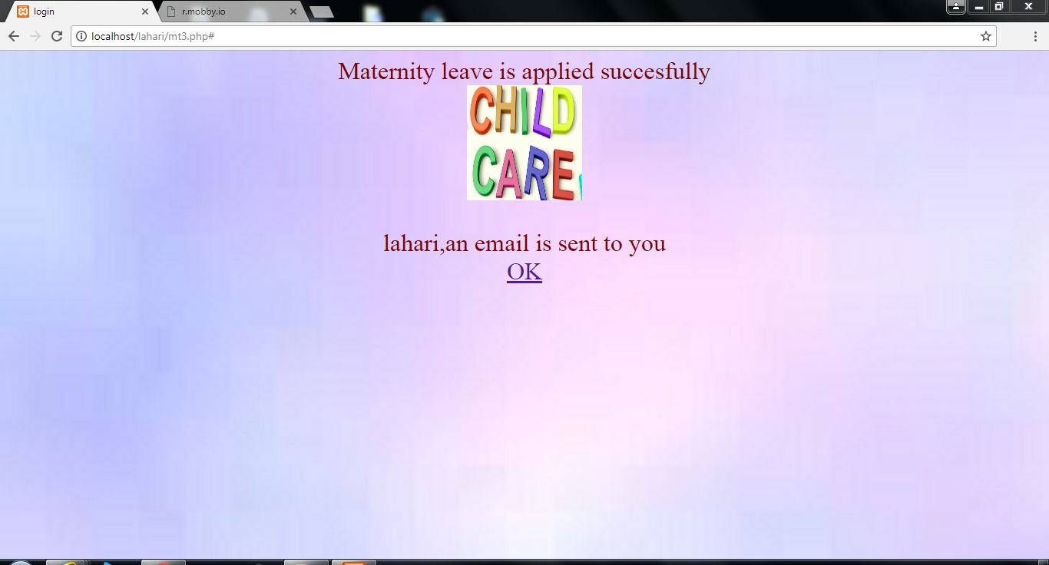
Output(Teacher Module)
When all leave conditions are satisfied then:

Slide 62
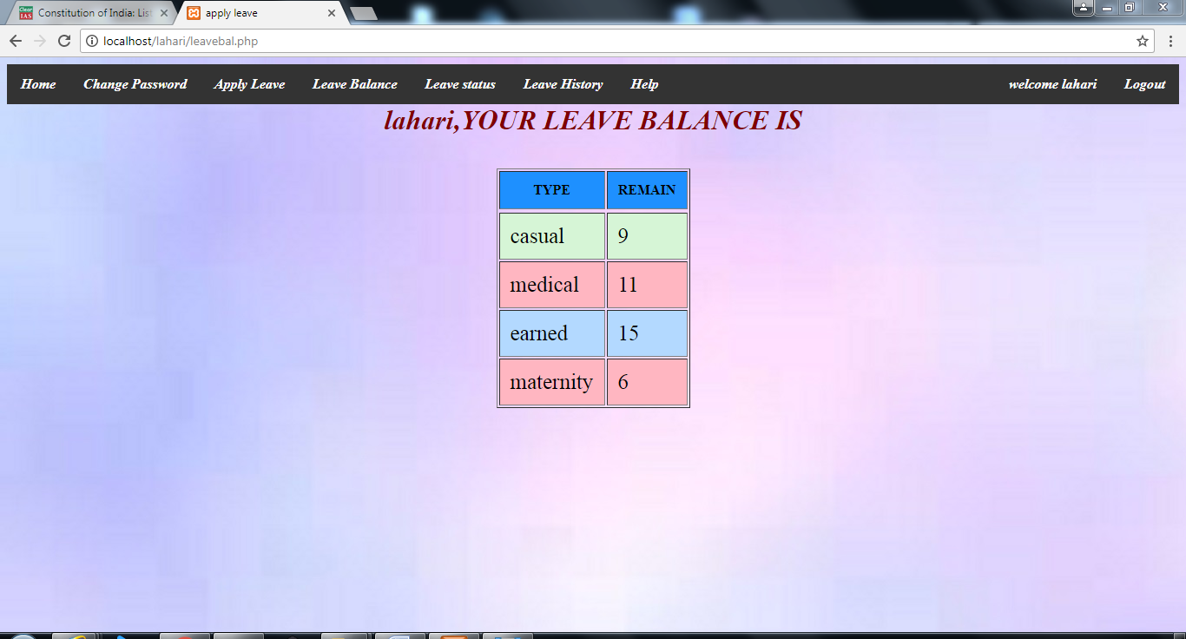
Output(Teacher Module)
Leave Balance(leavebal1.php)
If gender is “Female” then leave balance is displayed as:

Slide 63
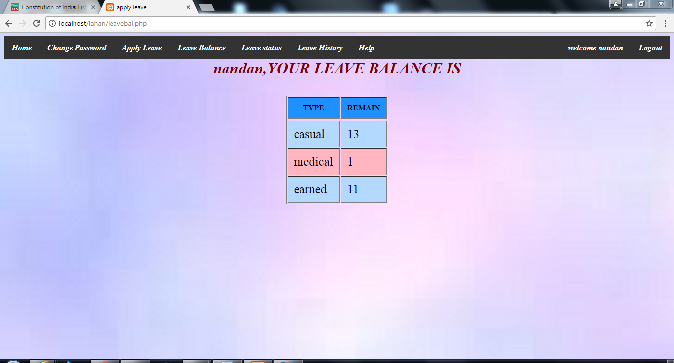
Output(Teacher Module)
Leave Balance(leavebal1.php)
If gender is “Male” then leave balance is displayed as:

Slide 64
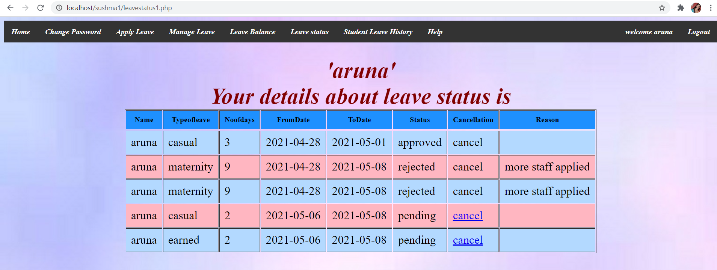
Output(Teacher Module)
Leave Status(leavestatus1.php)

Slide 65
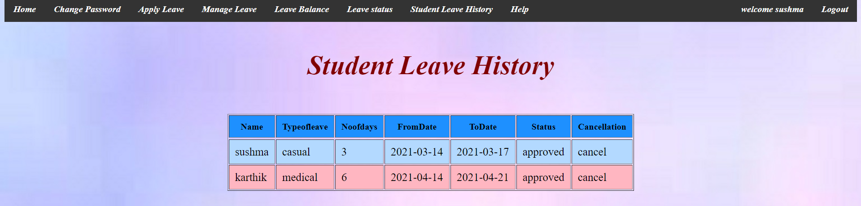
Output(Teacher Module)
Student Leave History(leavehistory1.php)

Slide 66

Output(Student Module)
Student Login(login2.php)

Slide 67
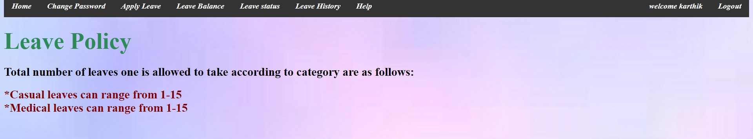
Output(Student Module)
lp.php

Slide 68
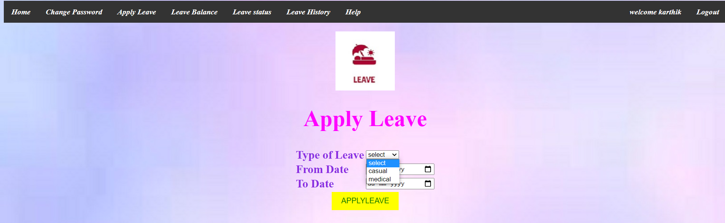
Output(Student Module)
Apply Leave(applyleave.php)

Slide 69
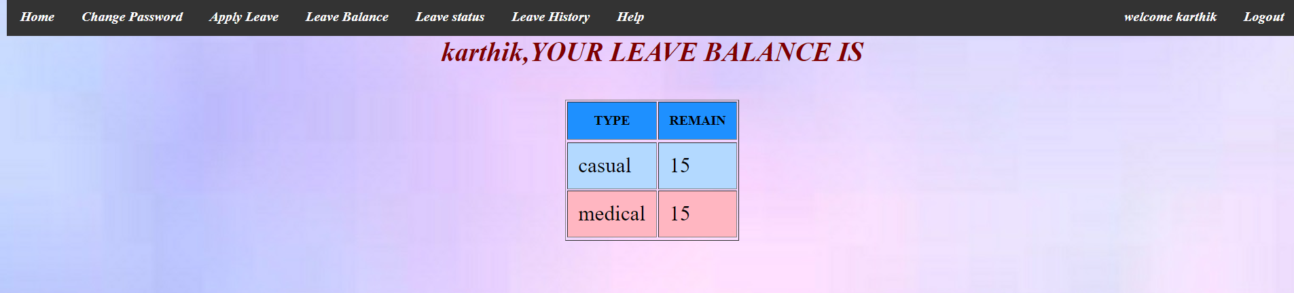
Output(Student Module)
Leave Balance(leavebal.php)

Slide 70
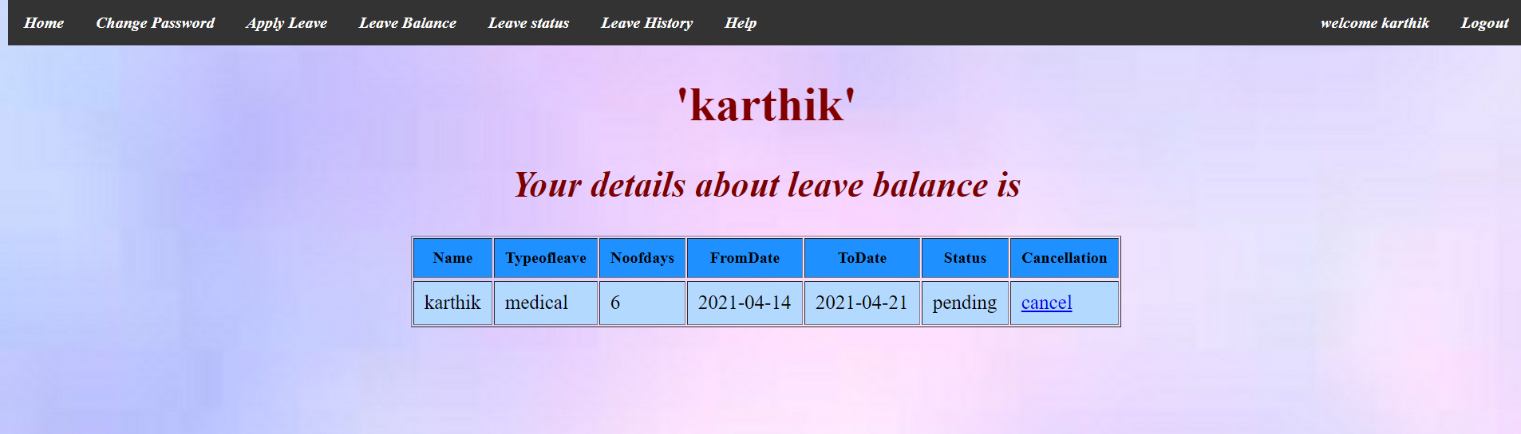

Output(Student Module)
Leave Status(leavestatus.php)
cancel1.php

Slide 71
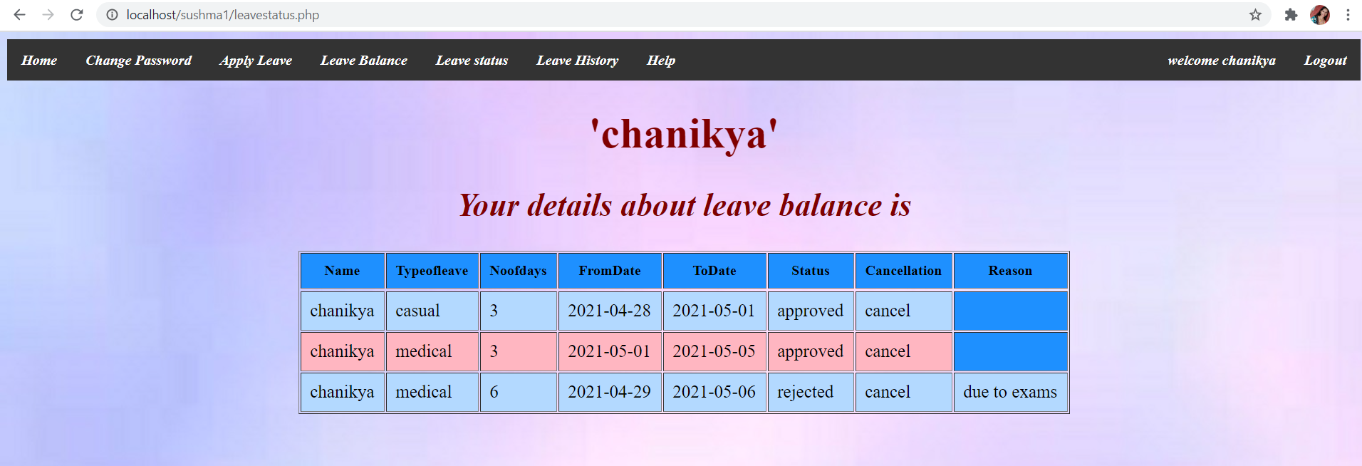
Output(Student Module)
Leave Status(leavestatus.php)

Slide 72
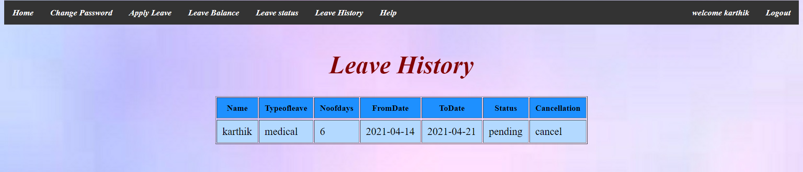
Output(Student Module)
Leave History(leavehistory.php)

Slide 73
Conclusion
The new Leave Management System allows the Faculty and Students to apply for a leave or cancel a leave and he/she can also view the remaining leaves, the superior can approve or disapprove the leave applied by a student/teacher.
The new system is an improvement on manual leave process in the following ways:
User can apply leave through online being at home.
Reduces strain for individuals.
Allowing admin or superior to cancel the leave.
Adding maternity leave as a leave type solely for female users.
Restriction on taking casual leaves during special events

Slide 74


